Slide 1
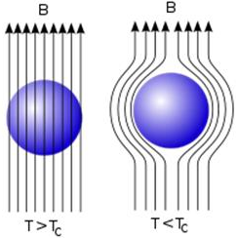

Superconductors and their applications
Diamagnetism and the Meissner effect:
Diamagnetism→ When a current is induced in a material to oppose an applied magnetic field. These induced currents produce magnetisation in the material, again opposing the applied field.
Superconductors have perfect diamagnetism, this is the Meissner effect. All internal fields are expelled from the material by the induced currents.
Magnetic field lines, represented as arrows
Superconductor basics
Definition
Properties e.g. R=0, magnetic field expelled
Graphs
Critical temp
London equations:
Uses:
j_{s} | Superconducting current density
E | Electric Field Strength
B | Magnetic Field Strength
e | Elementary Charge
m | Electron Mass
n_{s} | phenomenological constant loosely associated with a number density of superconducting carriers
∇ X j_{s} | Curl j_{s} (infinitesimal rotation of a 3-D vector field)
Eleanor Grogan, Kristopher Green and Amber Summerly

